Slide 1

Hotel billing using python
By:-
s.saikiran kumar reddy
18881A1251

Slide 2
Abstract/Problem Statement
•The manual billing system is time consuming: It takes time to compute the bill of customers in the existing system due to the manual process being used.
•Human error due to miscalculations: Miscalculations can occur as a result of human error such as error of omission and wrong calculation.
•It is difficult to easily manage and update billing information: If there is need
to correct a billing record or make changes, it will be difficult to instantly find and update the bill record of the particular customer.

Slide 3
features
•The user enters customer details and selects items from the menu.
•The system displays the menu as category wise.
•The selected item will be displayed in the item frame from where
the user can add items, remove items, update the quantity.
•You can see the changes in the Order list in the order frame.
•Users can generate bills after selecting at least 1 item.
•Order cancellation is also provided.
•The system displays a bill in the new window to the user and saves it in the
‘Bill Records’ folder.

Slide 4
LITRACY SURVEY ( RELATED WORK)
Billing is a financial accounting concept for business organizations such as hotel industry to bill their customers for services rendered and the billing report is utilized by management to know the income generated. Hotel billing record system is used to capture the bill record of customers to come up with a total amount to be paid by the customer. The information is saved to a database to enable management or users to retrieve saved billing records.

Slide 5
objectives
-> To design a system to compute billing information of customers of the hotel industry.
->To design a system that can be used to store customers billing records.
->To implement a system that can be used to retrieve and update customer billing records easily.

Slide 6

Technology
-The technology used is only python and tkinter module.
-For the frontend frame work i used tkinter module.
Tkinter is the Python interface to the Tk GUI toolkit shipped with Python.

Slide 7
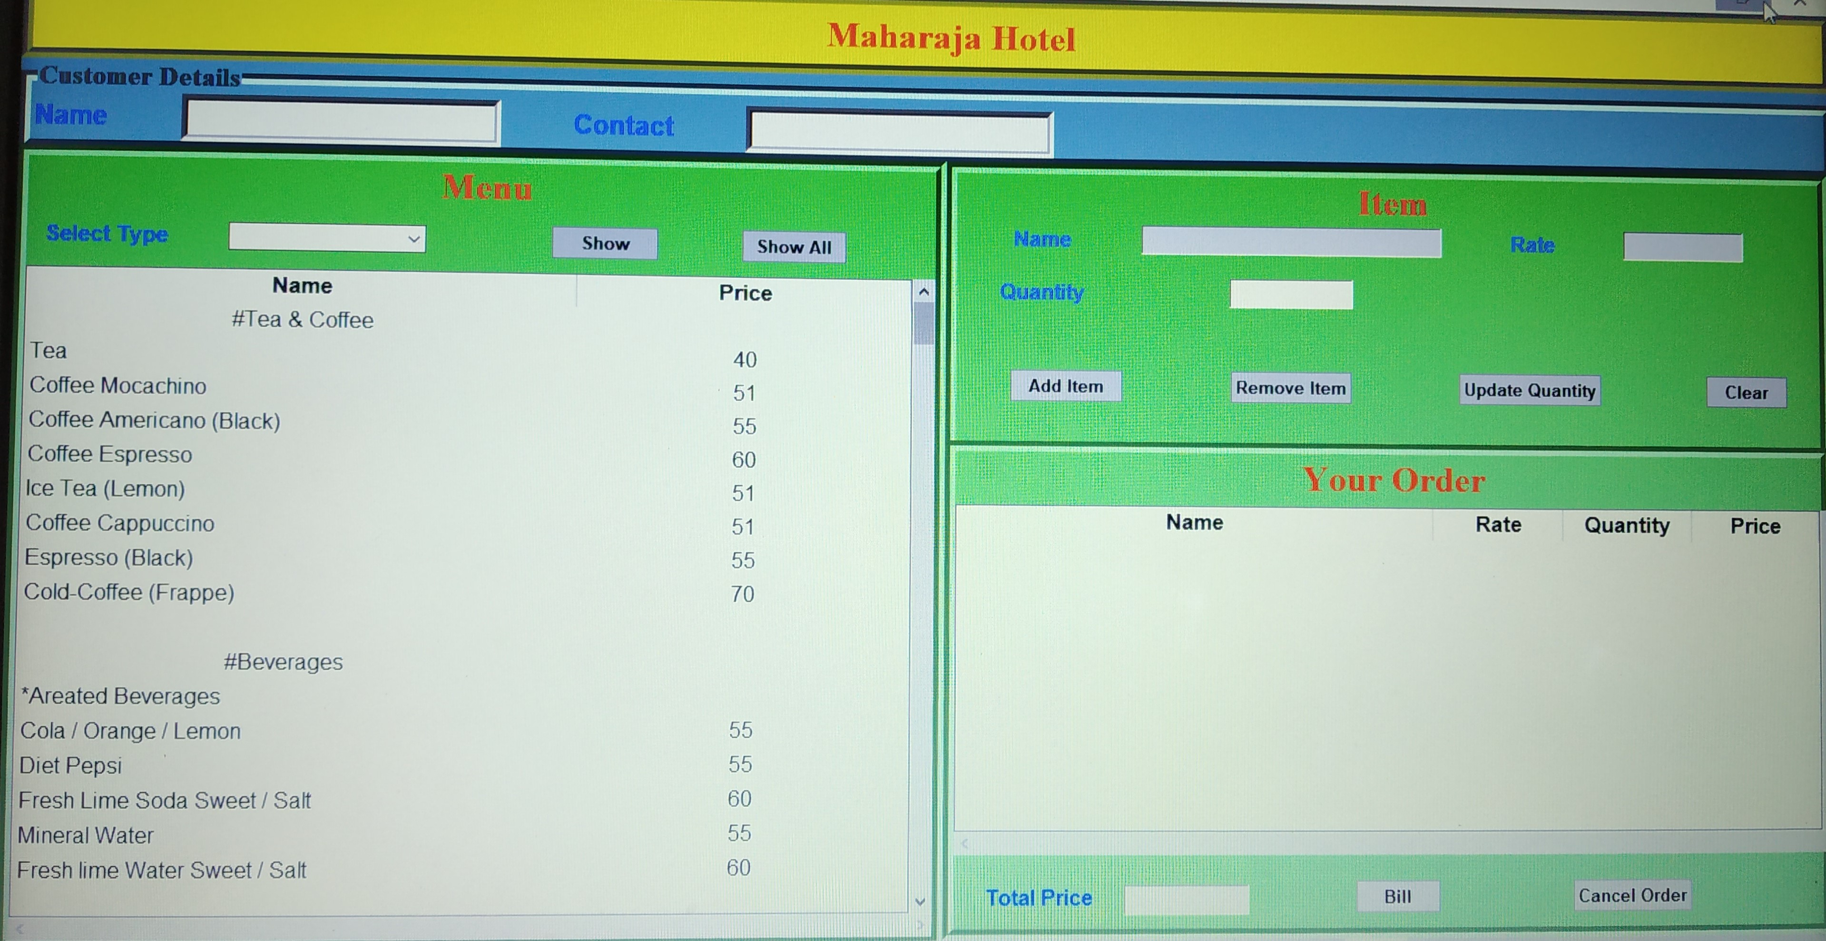
Model of billing system

Slide 8



